Slide 1
R introduction (I)
2014 summer
Chi Zhang

Slide 2
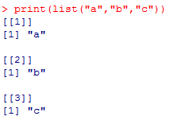
Print
print(matrix(c(1,2,3,4), 2, 2))
print(list("a","b","c"))

Slide 3
Results in academic paper
Figures!
Tables!
Conclusions!
Formulas, method evaluation for method papers.

Slide 4
Basis functions
ls()
rm()
c() #creating a vector, c() is a function
mode() #
class() #
mean(x)
median(x)
sd(x)
var(x)
cor(x, y) #http://en.wikipedia.org/wiki/Pearson_product-moment_correlation_coefficient
cov(x, y)

Slide 5
Working directory
getwd()
setwd(“****”)
list.files()
load(“****”)
save.image(“****”)

Slide 6
history()
history()
history(100)
history(Inf)

Slide 7
Creating Sequences
1:5
5:1
seq(from=0, to=20, by=5)
1.1:10.1
1.1:10.3
a<-rep(0,3)
rep(c(1,2,a),2)

Slide 8
Basic calculations
+
-
*
/
%%
^
%*% #matrix multiply
log(x)
sin(x)
exp()
e
Pi
Inf
NA

Slide 9
Comparison and logic operations
<
>
<=
>=
==
!=
is.***(x) #function, return whether x is ***
| # or
& # and
! # not

Slide 10
Selecting Vector Elements
a<-c(1,23,4,56,7,8,9)
a[1]
a[1,2]
a[c(1,2)]
a[-1]
a[1:3]

Slide 11
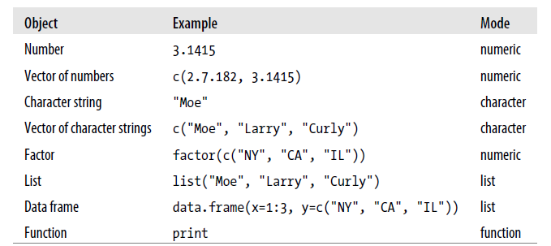
Data mode: Physical Type
mode(3.1415) # Mode of a number
[1] "numeric"
> mode(c(2.7182, 3.1415)) # Mode of a vector of numbers
[1] "numeric"
> mode("Moe") # Mode of a character string
[1] "character"

Slide 12
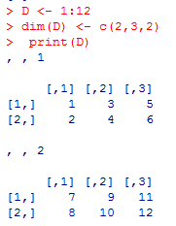
Data Class: Abstract type
scalar
array (vector)
matrix
From array to matrix
factor (looks like a vector, but has special properties, for Categorical variables or grouping)
data.frame

Slide 13
data.frame matrix
Same data mode in each column
Unique Row/column names (rownames, colnames)
One row of a data.frame is a data.frame
as.data.frame(****)
Same data mode in the whole matrix
Can have repeated Row/column names
One row of matrix is an array (vector)
as.matrix(****)

Slide 14
Data types we will deal with
Clinical data-> data.frame
Experimental data-> data.frame or matrix
Microarray data
RNA seq data
Somatic mutation data
Protein array
DNA methylation data

Slide 15
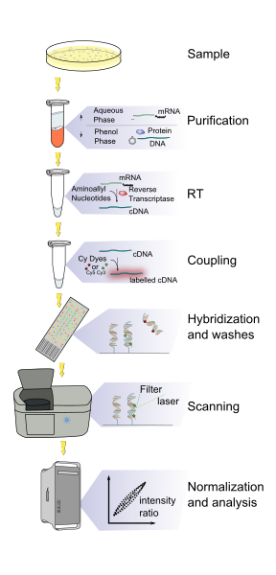
Microarray data
Intensity
Not sensitive to transcripts with low abundance
Hybirdization
Probe design!.

Slide 16
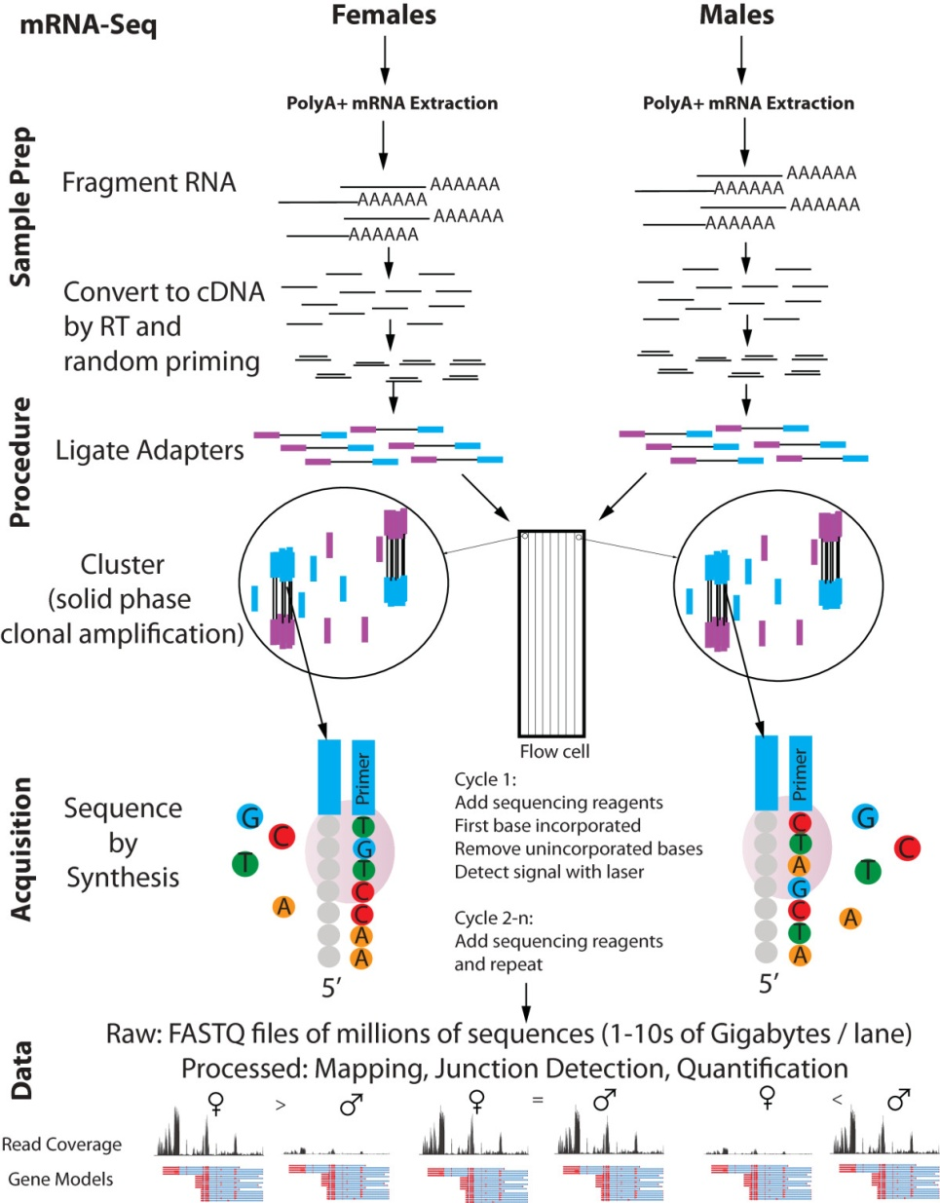
RNA seq
Reads count
PCR bias
Good sensitivity

